Slide 1


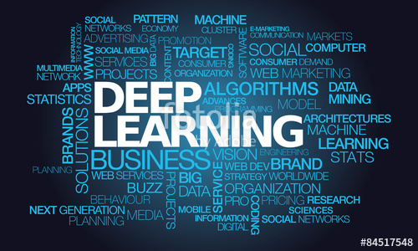

DEEP LEARNING

Slide 2
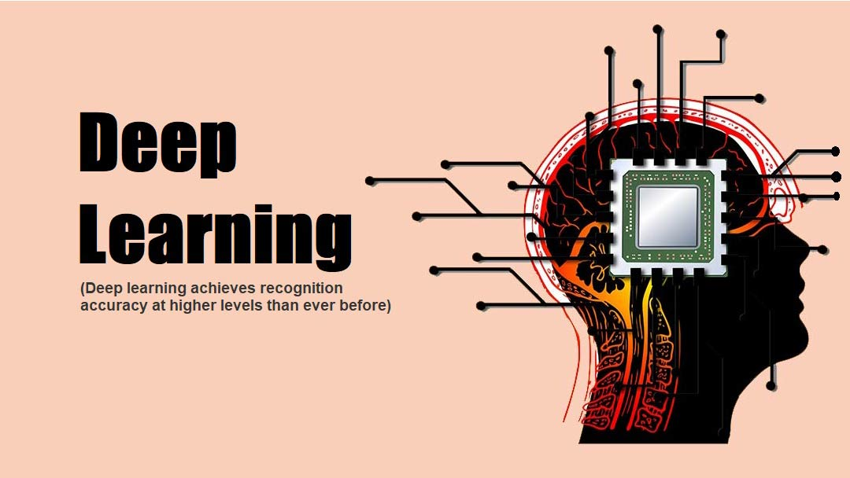
Deep Learning
Deep Learning is a subfield of machine learning concerned with algorithms inspired by the structure and function of the brain called artificial neural networks.
In deep learning, a computer model learns to perform classification tasks directly from images, text, or sound.
Deep learning models can achieve state-of-the-art accuracy, sometimes exceeding human-level performance.
Models are trained by using a large set of labelled data and neural network architectures that contain many layers.
Deep learning requires large amounts of labeled data. For example, driverless car development requires millions of images and thousands of hours of video.
Deep learning requires substantial computing power. High-performance GPUs have a parallel architecture that is efficient for deep learning. When combined with clusters or cloud computing, this enables development teams to reduce training time for a deep learning network from weeks to hours or less.

Slide 3
Deep Learning
How Deep Learning Works:
Most deep learning methods use neural network architectures, which is why deep learning models are often referred to as deep neural networks.
The term “deep” usually refers to the number of hidden layers in the neural network. Traditional neural networks only contain 2-3 hidden layers, while deep networks can have as many as 150.
Deep learning models are trained by using large sets of labeled data and neural network architectures that learn features directly from the data without the need for manual feature extraction.
One of the most popular types of deep neural networks is known as (CNN or ConvNet).
The CNN works by extracting features directly from images. The relevant features are not pretrained; they are learned while the network trains on a collection of images.
This automated feature extraction makes deep learning models highly accurate for computer vision tasks such as object classification.

Slide 4
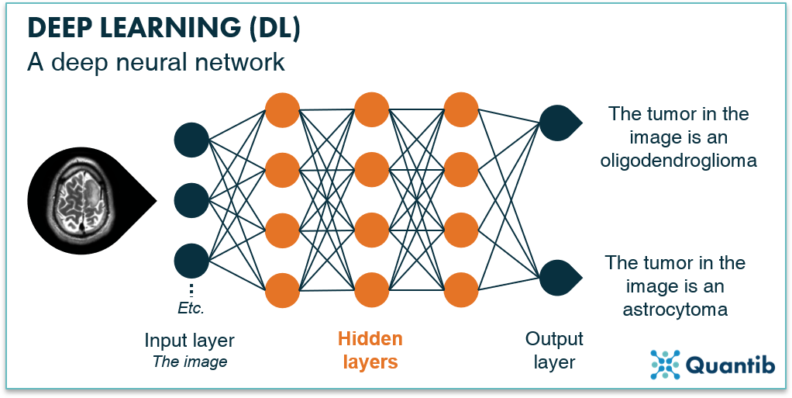
Deep Learning

Slide 5
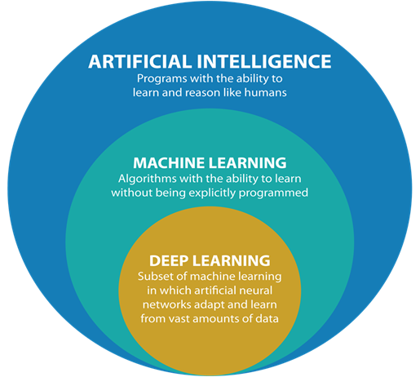
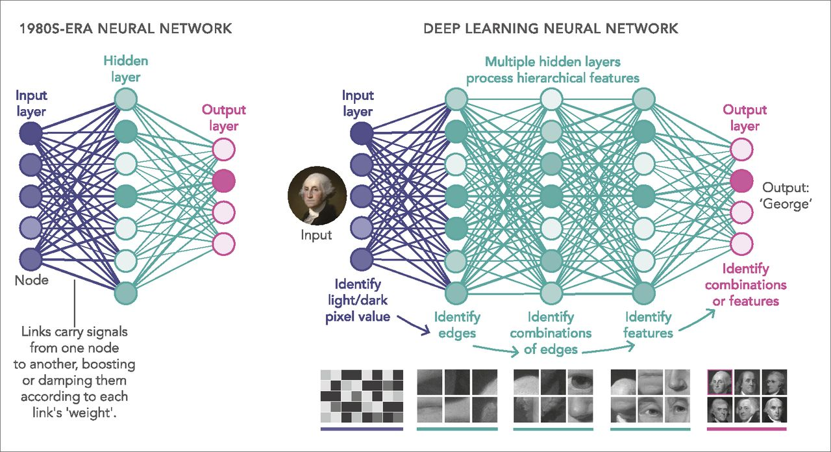
Deep Learning

Slide 6
Deep Learning
Deep learning applications:
Automated Driving:Automotive researchers are using deep learning to automatically detect objects such as stop signs and traffic lights. In addition, deep learning is used to detect pedestrians, which helps decrease accidents.
Aerospace and Defense: Deep learning is used to identify objects from satellites that locate areas of interest, and identify safe or unsafe zones for troops.
Medical Research: Cancer researchers are using deep learning to automatically detect cancer cells.
Industrial Automation: Deep learning is helping to improve worker safety around heavy machinery by automatically detecting when people or objects are within an unsafe distance of machines.
Electronics: Deep learning is being used in automated hearing and speech translation. For example, home assistance devices that respond to your voice and know your preferences are powered by deep learning applications.

Slide 7
Neural Networks
As the name suggests, the design of Artificial Neural Networks (ANNs) is inspired by the human brain.
Although not as powerful as the brain (yet), artificial neural networks are the most powerful learning models in the field of machine learning.
In the past few years, deep artificial neural networks have proven to perform surprisingly well on complex tasks such as speech recognition (converting speech to text), machine translation, image and video classification, etc.
working principles of artificial neural networks - information flow in feedforward networks, training using backpropagation, optimisation techniques, hyperparameter tuning etc are very important.
Implementation of neural networks using Keras (a high-level, user-friendly interface) TensorFlow (the low-level workhorse library) as the backend.

Slide 8
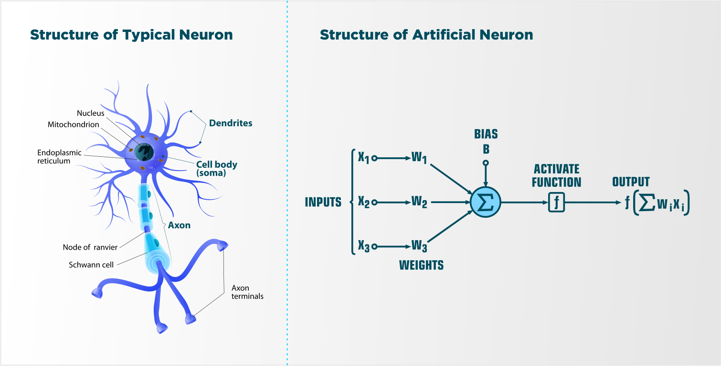
Neural Networks
Simply speaking, the biological neuron works as follows - it receives signals through its dendrites which are either amplified or inhibited as they pass through the axons to the dendrites of other neurons.

Slide 9
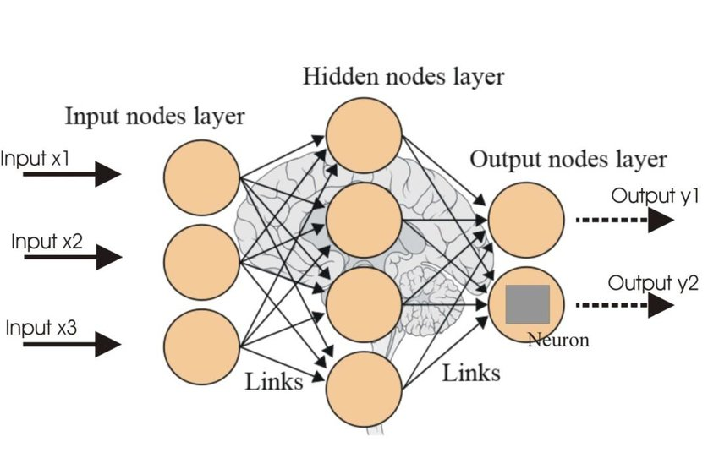
Neural Networks
Artificial Neural Networks, are a collection of a large number of simple devices called artificial neurons. Neurons in a neural network are arranged in layers. The first and the last layer are called the input and output layers. Input layers have as many neurons as the number of attributes in the data set and the output layer has as many neurons as the number of classes of the target variable (for a classification problem). For a regression problem, the number of neurons in the output layer would be 1 (a numeric variable).

Slide 10
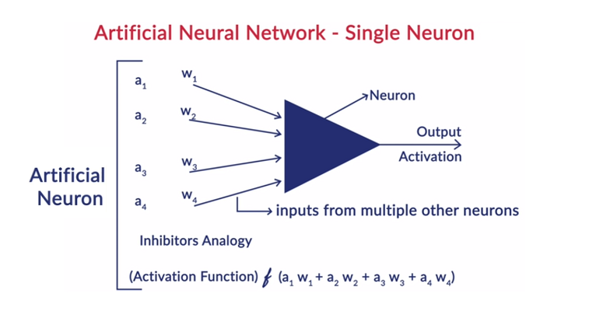
Neural Networks

Slide 11
Neural Networks
Working of a Neuron:
Neural networks are a collection of artificial neurons arranged in a particular structure.
What is ANN – it is basically a network of a neurons, neuron can take several inputs from multiple other neurons, and output goes into several neurons.
We associate weights for each of the inputs, these weights will amplify the inputs coming from the other neuron or suppress it, the moment you make weight o for one particular input then it gets blocked.
The cumulative input that is coming inside is weighted sum of the outputs of the neurons that we are feeding in this, we normally refer output of a neuron is activation.so, suppose if inputs coming were activations from other neurons a1, a2… then the input becomes the cumulative input into the neuron, let the neuron do some transformation to the input that transformation is what results in activation. The transformation is usually thought of function, usually applied to c input then that function is called as the activation function.
Neuron is very similar to a perceptron, the only difference being that there is an activation function applied to the weighted sum of inputs. In perceptron’s, the activation function is the step function,

Slide 12
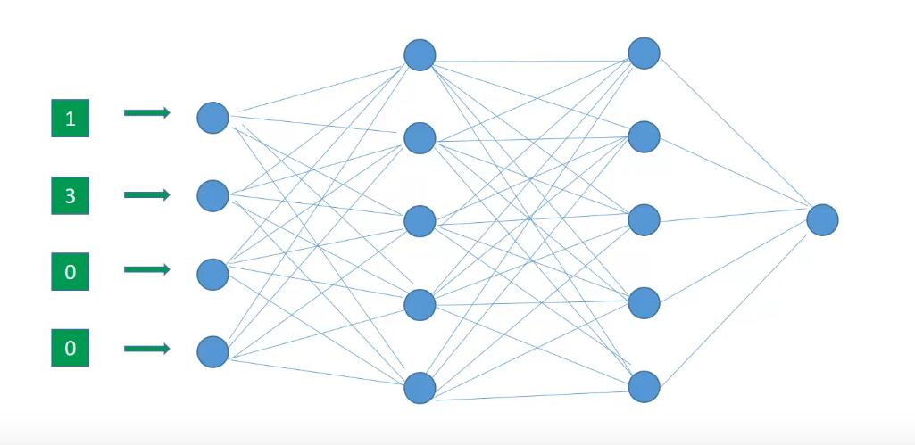
Neural Networks
Forward Propagation In Neural Networks:
forward propagation means we are moving in only one direction, from input to the output, in a neural network.
first step of training a neural network is Forward Propagation.
forward propagation by randomly initializing the weights of all neurons.
These weights are depicted by the edges connecting two neurons. Hence the weights of a neuron can be more appropriately thought of as weights between two layers since edges connect two layers.

Slide 13
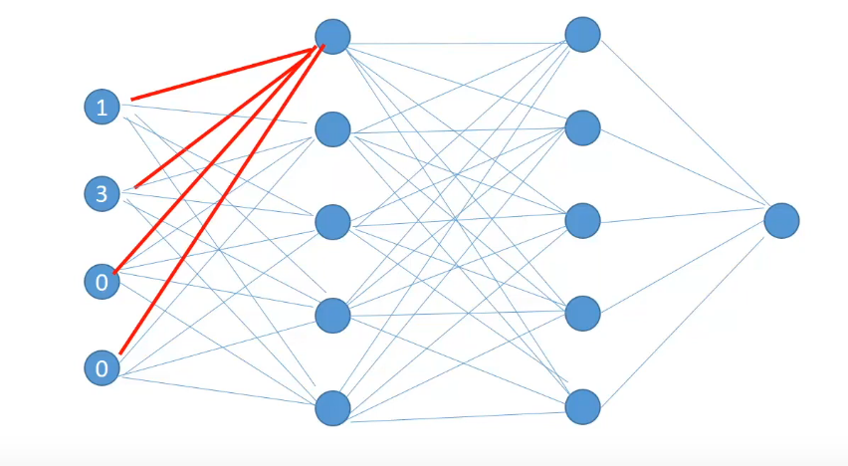
Neural Networks
This neuron receives input from all the neurons in the previous layer and combines it with its own set of weights represented by the red edges. And after applying some activation function, calculates the output known as Hidden Activation for this neuron.
The output of the hidden activation will serve as input for the next layer neurons. Similarly, the hidden activations for all of the neurons in the layer are calculated.
So all the activations for the first hidden layer have been calculated. These activations will serve as inputs to the layer after them. Once the hidden activations for the last hidden layer are calculated, they are combined by a final set of weights between the last hidden layer and the output layer to produce an output for a single row observation.

Slide 14
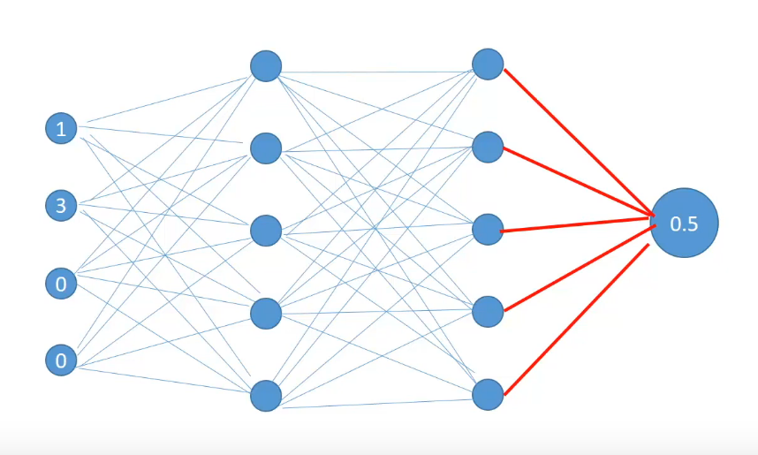
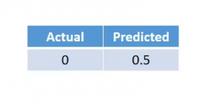
Neural Networks
calculations of the first row features in a dataset is 0.5 and the predicted value becomes 0.5 against the actual value of 0.
series of calculations which takes us from the input to output is called Forward Propagation.

Slide 15
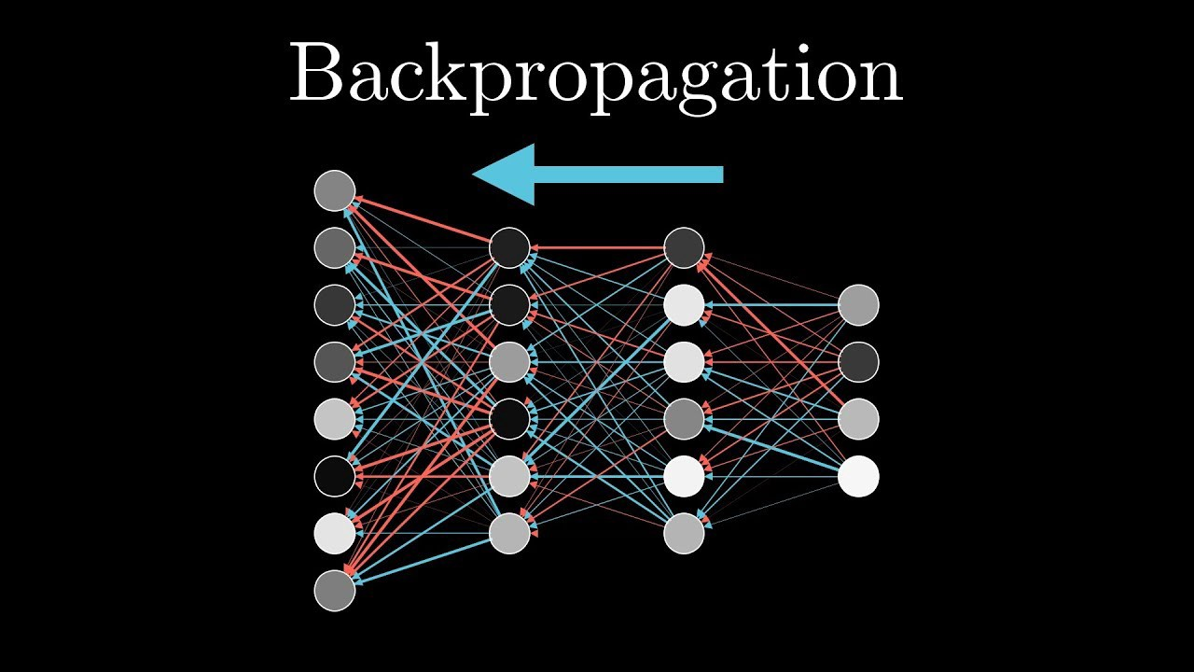
Neural Networks

Slide 16
Neural Networks
Backward Propagation:
The process of moving from the right to left i.e. backward from the Output to the Input layer is called the Backward Propagation.
Backward Propagation is the preferable method of adjusting or correcting the weights to reach the minimized loss function.
Backward Propagation is the preferred method for adjusting the weights and biases, since it is faster to converge as we move from output to the hidden layer.
Here, we change the weights of the hidden layer that is closest to the output layer, re-calculate the loss and if further need to reduce the error then repeat the entire process and in that order move towards the input layer.
The Backpropagation algorithm looks for the minimum value of the error function in weight space using a technique called the delta rule or gradient descent. The weights that minimize the error function is then considered to be a solution to the learning problem.

Slide 17
Neural Networks
Why Backpropagation:
While designing a Neural Network, in the beginning, we initialize weights with some random values or any variable for that fact.
it’s not necessary that whatever weight values we have selected will be correct, or it fits our model the best.
we have selected some weight values in the beginning, but our model output is way different than our actual output i.e. the error value is huge.
Now, how will you reduce the error?
The Backpropagation algorithm looks for the minimum value of the error function in weight space using a technique called the delta rule or gradient descent. The weights that minimize the error function is then considered to be a solution to the learning problem

Slide 18
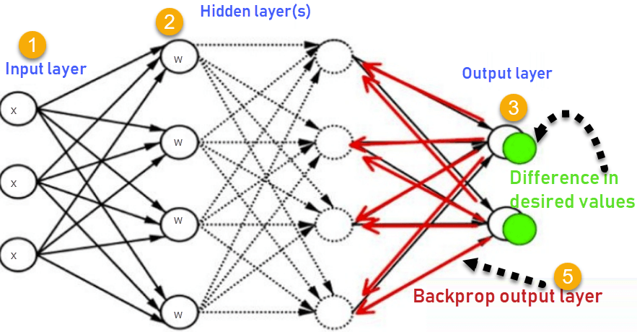
Neural Networks

Slide 19
Neural Networks
Backpropagation steps:
Backpropagation is the essence of neural network training. It is the method of fine-tuning the weights of a neural network based on the error rate obtained in the previous epoch (i.e., iteration). Proper tuning of the weights allows you to reduce error rates and make the model reliable by increasing its generalization.
Calculate the error – How far is your model output from the actual output.
Minimum Error – Check whether the error is minimized or not.
Update the parameters – If the error is huge then, update the parameters (weights and biases). After that again check the error. Repeat the process until the error becomes minimum.
Model is ready to make a prediction – Once the error becomes minimum, you can feed some inputs to your model and it will produce the output.

Slide 20
Neural Networks
Kera's layers: Introduction
A Kera's layer requires shape of the input (input_shape) to understand the structure of the input data, initializer to set the weight for each input and finally activators to transform the output to make it non-linear. In between, constraints restricts and specify the range in which the weight of input data to be generated and regularizer will try to optimize the layer (and the model) by dynamically applying the penalties on the weights during optimization process.
To summarize, Kera's layer requires below minimum details to create a complete layer.
Units: To determine the number of nodes/ neurons in the layer.
Initializer: To determine the weights for each input to perform computation.
Activators: To transform the input in a nonlinear format, such that each neuron can learn better.
Constraints: To put restrictions on weights at the time of optimization.
Regularizers: To apply a penalty on the parameters during optimization.

Slide 21
Neural Networks
Kera's layers are the primary building block of Kera's models. Each layer receives input information, do some computation and finally output the transformed information.
The output of one layer will flow into the next layer as its input.
Layers are the primary unit to create neural networks. We compose a deep learning architecture by adding successive layers.
Each successive layer performs some computation on the input it receives.
Then after it propagates the output information to the next layer.
At last, we get the desired results from the output of the last layer.
Once we import the necessary modules then Create a new model using Sequential API. Now we can create a new Dense layer and add it into the model.

Slide 22
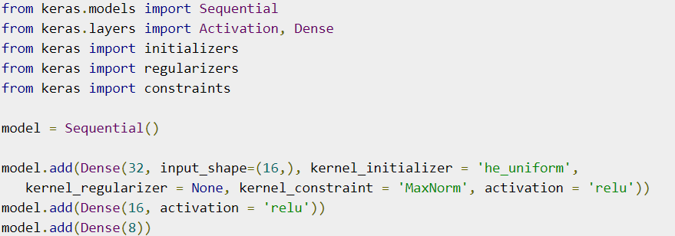
Neural Networks
Dense is an entry level layer provided by Keras, which accepts the number of neurons or units (32) as its required parameter. If the layer is first layer, then we need to provide Input Shape(16) as well. Otherwise, the output of the previous layer will be used as input of the next layer. All other parameters are optional.
First parameter represents the number of units (neurons).
Parameters
input_shape represent the shape of input data.
kernel_initializer represent initializer to be used
kernel_regularizer represent regularizer to be used.
kernel_constraint represent constraint to be used- MaxNorm function is set as value.
activation represent activation to be used.

Slide 23
Neural Networks
Activation Functions:
Activation functions are the most crucial part of any neural network in deep learning.
In deep learning, very complicated tasks are image classification, object detection, etc. which are needed to address with the help of neural networks and activation function.
AF basically decide to deactivate neurons or activate them to get the desired output. It also performs a nonlinear transformation on the input to get better results on a complex neural network.
AF also helps to normalize the output of any input in the range between 1 to -1.
Activation function must be efficient and it should reduce the computation time because the neural network sometimes trained on millions of data points.
ANNs use activation functions (AFs) to perform complex computations in the hidden layers and then transfer the result to the output layer.
The primary purpose of AFs is to introduce non-linear properties in the neural network.

Slide 24
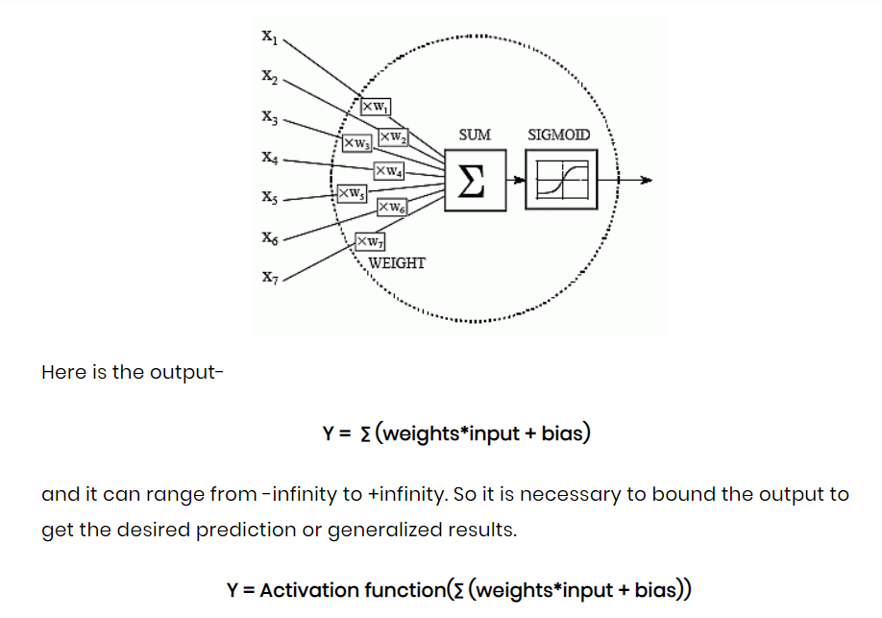
Neural Networks
activation function is an important part of an artificial neural network.
They decide whether a neuron should be activated or not
The neuron is basically is a weighted average of input, then this sum is passed through an activation function to get an output.
Here Y can be anything for a neuron between range -infinity to +infinity. So, we have to bound our output to get the desired prediction or generalized results
So, we pass that neuron to activation function to bound output values.

Slide 25
Neural Networks
The most famous activation functions are given below:
Linear
ReLU
LeakyReLU
Sigmoid
Tanh
Softmax
Linear Activation Function:
It is a simple straight line activation function where our function is directly proportional to the weighted sum of neurons or input. Linear activation functions are better in giving a wide range of activations and a line of a positive slope may increase the firing rate as the input rate increases.
Y = mZ

Slide 26
Neural Networks
ReLU( Rectified Linear unit) Activation function:
Rectified linear unit or ReLU is most widely used activation function right now which ranges from 0 to infinity.
ReLU has been the most widely used activation function for DL applications with state-of-the-art results.
It provides the upper hand in performance and generalization compared to the Sigmoid and Tanh activation functions.
Along with the overall speed of computation enhanced, ReLU provides faster computation since it does not compute exponentials and divisions.
It easily overfits compared to the sigmoid function and is one of the main limitations. Some techniques like dropout are used to reduce the overfitting.

Slide 27
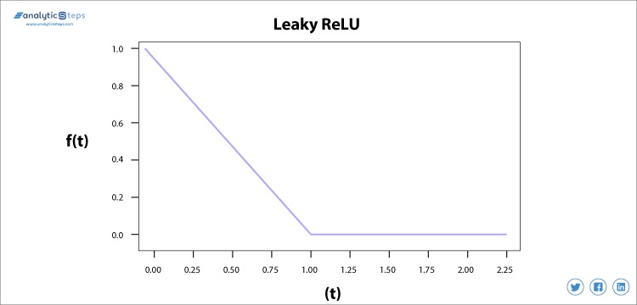
Neural Networks
Leaky ReLU Activation Function:
We needed the Leaky ReLU activation function to solve the ‘Dying ReLU’ problem. We use Leaky ReLU function instead of ReLU to avoid this unfitting, in Leaky ReLU range is expanded which enhances the performance.

Slide 28
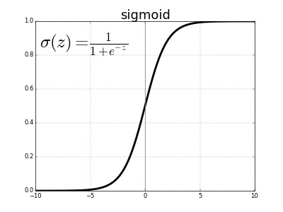
Neural Networks
Sigmoid Activation Function:
This AF is used mostly used as it does its task with great efficiency, it basically is a probabilistic approach towards decision making and ranges in between 0 to 1, so when we have to make a decision or to predict an output, we use this activation function because of the range is the minimum. therefore, prediction would be more accurate.
The equation for the sigmoid function is f(x) = 1/(1+e^{(-x)} )
The sigmoid function causes a problem mainly termed as vanishing gradient problem which occurs because we convert large input in between the range of 0 to 1 and therefore their derivatives become much smaller which does not give satisfactory output.
To solve this problem another activation function such as ReLU is used where we do not have a small derivative problem.

Slide 29
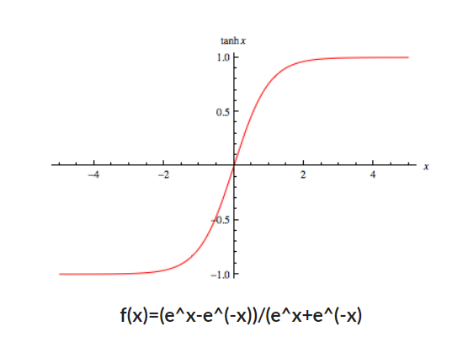
Neural Networks
Hyperbolic Tangent Activation Function(Tanh):
This activation function is slightly better than the sigmoid function.
Tanh is like the sigmoid function, it is also used to predict or to differentiate between two classes but it maps the negative input into negative quantity only and ranges in between -1 to 1.
It is advised to use tanh function instead of sigmoid function if your output is other than 0 and 1.
The tanh functions have been used mostly in RNN for natural language processing and speech recognition tasks.

Slide 30
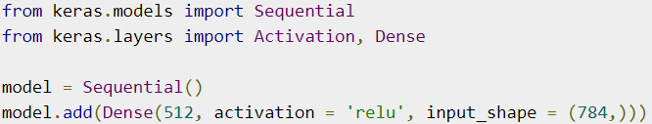
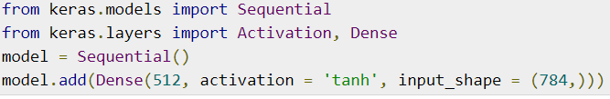
Neural Networks
Relu: Applies Rectified Linear Unit.
Tanh: Applies Hyperbolic tangent function.
Sigmoid: Applies Sigmoid function.

Slide 31
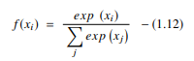
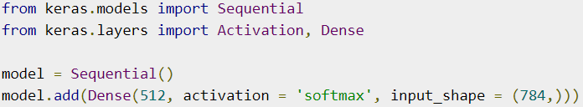
Neural Networks
Softmax Activation Function:
Softmax is used mainly at the last layer i.e. output layer for decision making the same as sigmoid activation works.
For Binary classification, both sigmoid, as well as SoftMax, are equally approachable but in case of multi-class classification problem we generally use SoftMax and cross-entropy.
This function generates an output that ranges between values 0 and 1 and with the sum of the probabilities being equal to 1.
The SoftMax function is represented as follows:

Slide 32
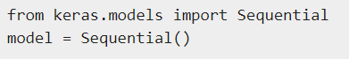
Neural Networks
Keras model: it represents the actual neural network model. Keras provides a two mode to create the model, simple and easy to use Sequential API as well as more flexible and advanced Functional API.
Sequential:
The core idea of Sequential API is simply arranging the Keras layers in a sequential order and so, it is called Sequential API.
Most of the ANN also has layers in sequential order and the data flows from one layer to another layer in the given order until the data finally reaches the output layer.
A ANN model can be created by simply calling Sequential() API as specified below

Slide 33
Neural Networks
Add layers:
To add a layer, simply create a layer using Keras layer API and then pass the layer through add() function as specified below
model = Sequential()
model. add( Dense(32, input_shape=(8,)))
model. add( Dense(64, activation='relu’))
model. add( Dense(8))
Train and Predict the model
compile − Configure the learning process of the model.
fit − Train the model using the training data.
evaluate − Evaluate the model using the test data.
predict − Predict the results for new input.

Slide 34
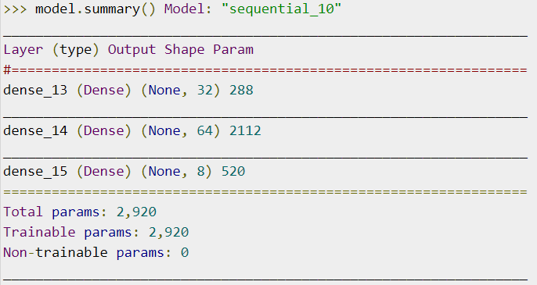
Neural Networks
Summarize the model:
Understanding the model is very important phase to properly use it for training and prediction purposes.
Kera's provides a simple method, summary to get the full information about the model and its layers.
A summary of the model

Slide 35
Neural Networks
Dropout Regularization: A Simple Way to Prevent Neural Networks from Overfitting.
A powerful regularization technique for neural networks and deep learning models. The key idea is to randomly drop units (along with their connections) from the neural network during training.
Dropout is easily implemented by randomly selecting nodes to be dropped out with a given probability (e.g. 20%) each weight update cycle. This is how Dropout is implemented in Kera’s.
Dropout is only used during the training of a model and is not used when evaluating the skill of the model.
This significantly reduces overfitting and gives major improvements over other regularization methods.
dropout improves the performance of neural networks on supervised learning tasks in vision, speech recognition, document classification and computational biology etc.

Slide 36
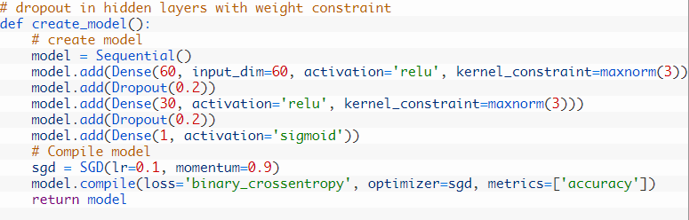
Neural Networks
Using Dropout on Hidden Layers:
Dropout can be applied to hidden neurons in the body of your network model.
In the example Dropout is applied between the two hidden layers and between the last hidden layer and the output layer.
Again a dropout rate of 20% is used as is a weight constraint on those layers.
The first parameter, is the probability p that a given unit will drop out. In this example, the probability is 0.2, which means that roughly 0.2 of the given units will drop out.

Slide 37
Neural Networks
Kera's Compile Models:
After defining our model and stacking the layers, we have to configure our model. We do this configuration process in the compilation phase.
Before training the model we need to compile it and define the loss function, optimizers, and metrics for prediction.
We compile the model using .compile() method.
Code:
model. Compile ( optimizer, loss, metrics, loss_weights, sample_weight_mode, weighted_metrics, target_tensors)
Optimizer, loss, and metrics are the necessary arguments.

Slide 38
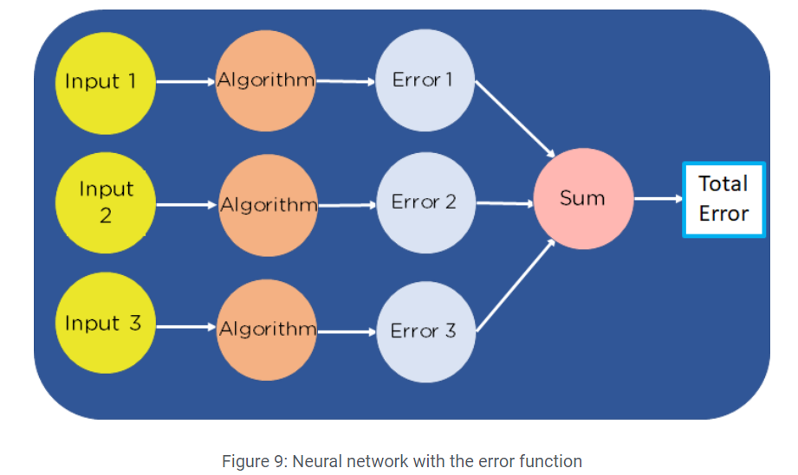
Neural Networks
Cost Function for Neural Networks:
A neural network is a circuit of neurons or series of algorithms for solving AI problems.
Network takes in multiple inputs, runs them through an algorithm, and essentially sums the output of the different algorithms to get the final output.
The cost function of a neural network will be the sum of errors in each layer.
This is done by finding the error at each layer first and then summing the individual error to get the total error.

Slide 39
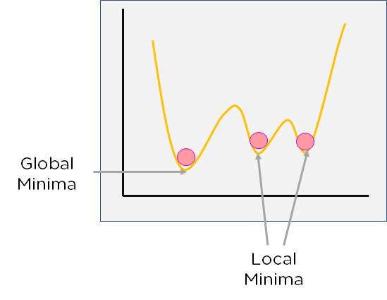
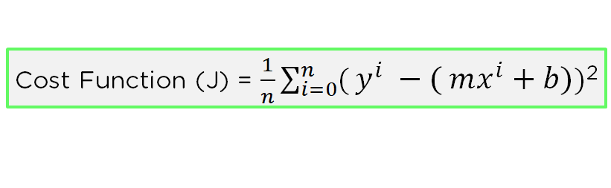
Neural Networks
Cost Function for Neural Networks:
For neural networks, each layer will have a cost function, and each cost function will have its own least minimum error value.
Depending on where you start, you can arrive at a unique value for the minimum error.
You need to find the minimum value out of all local minima. This value is called the global minima.

Slide 40
Neural Networks
Gradient Descent:
Gradient descent is a first-order iterative optimization algorithm used to minimize a loss function.
It’s a first-order optimization algorithm because, in every iteration, the algorithm takes the first-order derivative for updating the parameters.
Parameters refer to the weights of a neural network. These parameters are updated by the gradient which gives the direction of the steepest ascent.
In every iteration, this is performed by updating parameters in the opposite direction of the gradient computed for cost function L, w.r.t the parameters θ.
The size of the update is determined by the step size called learning rate α.

Slide 41
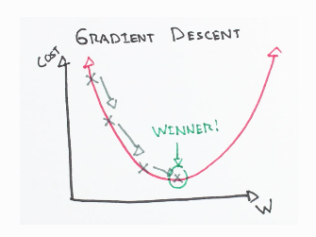
Neural Networks
Here Gradient Descent by measuring the local gradient of the error function and goes in the opposite direction of the gradient until we reach the global minimum.
The algorithm calculates the gradient of the cost function w.r.t every parameter θ.
which tells us the slope of our cost function at our current position (current parameter values) and the direction we should move to update our parameters.
The size of our update is controlled by the learning rate.
The most commonly used learning rates are : 0.3, 0.1, 0.03, 0.01, 0.003, 0.001.

Slide 42
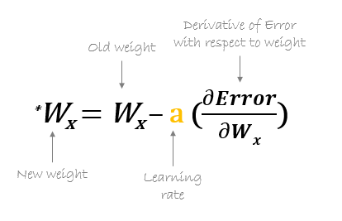
Neural Networks
Optimizers:
It is very essential to know that the most important function of the optimizer is to update the weights of the learning algorithm to reach the least cost function.
During the training process of a Neural Network, optimizer aim is to minimize the loss function, by updating Weights and make our predictions as accurate as possible.
Optimizer tries to lower the loss function by updating the model parameters in response to the output of the loss function.
Optimizer will be helping to reach the Global Minima with the lowest loss and most accurate output.
Here is the formula used by all the optimizers for updating the weights.

Slide 43
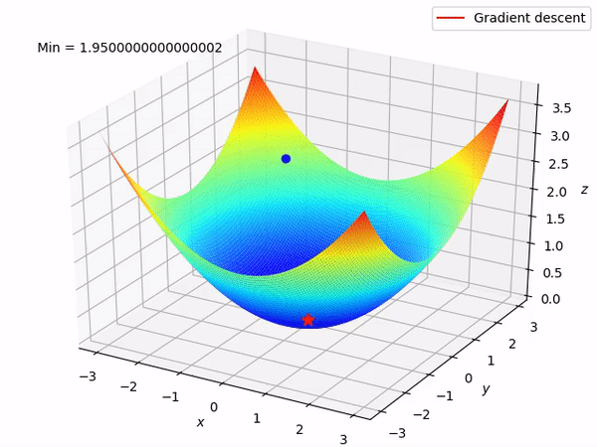
Neural Networks
TYPES OF OPTIMIZERS - different types of optimization algorithms.
Gradient Descent.
Stochastic Gradient Descent.
Adadelta.
RMSprop.
Adam.
Gradient Descent: one of the oldest and the most common optimizer
Used where the data is arranged in a way that it possesses a convex optimization problem.
Optimizer Updates the weights of the learning algorithm and will end up with the best-suited parameters corresponding to the Global Minima.
Vanishing Gradient problem may also occur due to incorrect parameter initialization which makes it difficult for the algorithm to converge.

Slide 44
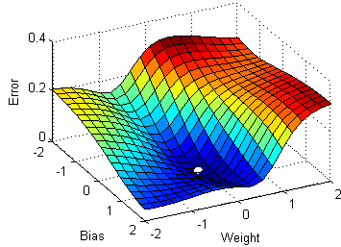
Neural Networks
Stochastic Gradient Descent:
Another variant of the Gradient Descent optimizer with an additional capability of working with the data with a non-convex optimization problem.
Rather than going for batch processing, this optimizer focuses on performing one update at a time.
It is therefore usually much faster, also the cost function minimizes after each iteration (EPOCH).
Here after several iterations gradient will jump to a potential Global Minima.

Slide 45
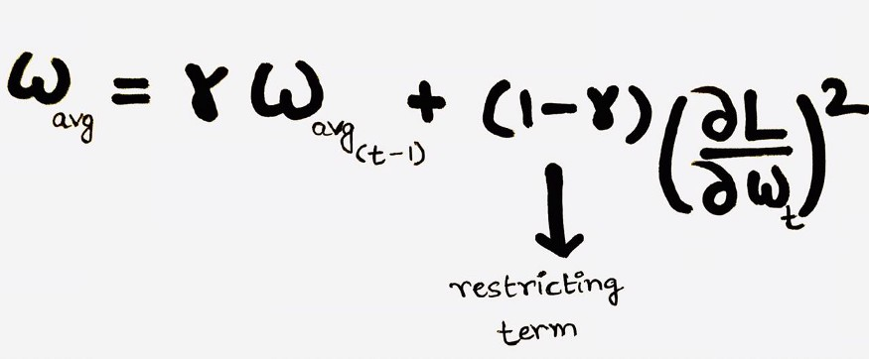
Neural Networks
Adadelta: extension of the Adaptive Gradient optimizer.
Here instead of using the previous squared gradients, the sum of gradients is defined as a reducing weighted average of all past squared gradients(weighted averages) this restricts the learning rate to reduce to a very small value.
At each iteration, first the weighted average is calculated. Where we have the restricting term(gamma = 0.95) which helps in avoiding the problem of Vanishing Gradient.
RMSprop: RMSprop and Ada delta were developed for the same purpose to solve Adagrad’s problem of destructive learning rates.
However, both use the same method which utilizes an Exponential Weighted Average to determine the learning rate at time t for each iteration.

Slide 46
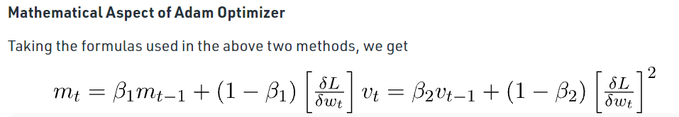
Neural Networks
Adam optimizer: Adaptive Moment Estimation is an algorithm for optimization technique for gradient descent.
The method is really efficient when working with large problems involving a lot of data or parameters.
It uses a combination of gradient descent with momentum and RMSprop to determine the parameter values.
Adam optimizer gives much higher performance than the previously used and outperforms them by a big margin into giving an optimized gradient descent.

Slide 47
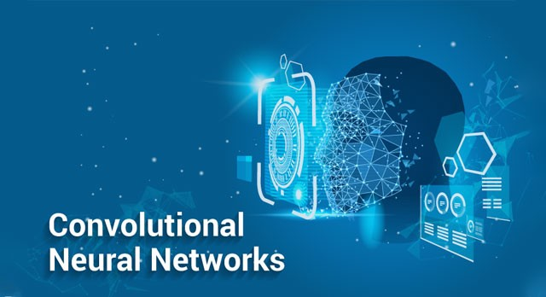
-
Introduction to CNNs:
A Convolutional Neural Network (ConvNet/CNN) is a Deep Learning algorithm which can take in an input image, assign importance (learnable weights and biases) to various aspects/objects in the image and be able to differentiate one from the other.
The pre-processing required in a ConvNet is much lower as compared to other classification algorithms.
convolutional neural networks (ConvNets or CNNs) are more often utilized for classification and computer vision tasks.
However, CNN now provide a more scalable approach to image classification and object recognition tasks, leveraging principles from linear algebra, specifically matrix multiplication, to identify patterns within an image.
CNN can be computationally demanding, requiring (GPUs) to train models.

Slide 48
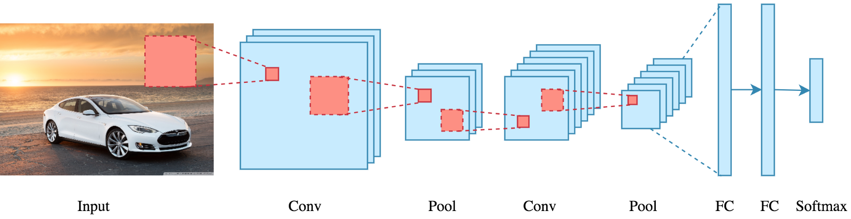
What exactly is a CNN: In deep learning, a convolutional neural network (CNN/ConvNet) is a class of deep neural networks, most commonly applied to analyse visual imagery. It uses a special technique called Convolution.
Bottom line is that the role of the ConvNet is to reduce the images into a form that is easier to process, without losing features that are critical for getting a good prediction.
The advancements in Computer Vision with Deep Learning have been constructed and perfected with time, primarily over one particular algorithm — a Convolutional Neural Network.

Slide 49
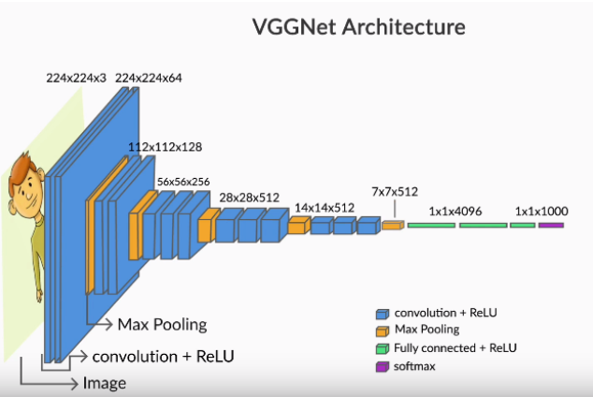
The VGGNet was specially designed for the ImageNet challenge which is a classification task with 1000 categories.
Thus, the SoftMax layer at the end has 1000 categories.
The blue layers are the convolutional layers while the yellow ones are pooling layers.
Finally, the green layer is a fully connected layer with 4096 neurons, the output from which is a vector of size 4096.

Slide 50
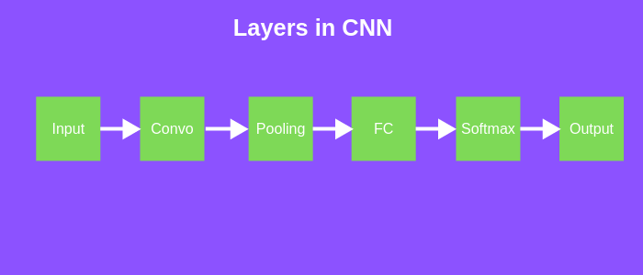
Layers in CNN
There are five different layers in CNN:
Input layer.
Convo layer (Convo + ReLU).
Pooling layer.
Fully connected (FC) layer.
SoftMax/logistic layer.
Output layer.

Slide 51
Input Layer: Input layer in CNN contains image data. Image data is represented by three-dimensional matrix.
Convo Layer: Convo layer is sometimes called feature extractor layer because features of the image are getting extracted within this layer. The output will be the input for the next layer.
Pooling Layer: Pooling layer is used to reduce the spatial volume of input image after convolution. It is used between two convolution layers.
Fully Connected Layer: Fully connected layer involves weights, biases, and neurons. It connects neurons in one layer to neurons in another layer. It is used to classify images between different category by training.
SoftMax / Logistic Layer: last layer of CNN. It resides at the end of FC layer. Logistic is used for binary classification and SoftMax is for multi-classification.
Output Layer: Output layer contains the label which is in the form of one-hot encoded.

Slide 52

How does it work: working of CNN’s
let’s cover the basics such as what is an image and how is it represented. An RGB image is nothing but a matrix of pixel values having three planes whereas a grayscale image is the same but it has a single plane.
In the figure, we have an RGB image which has been separated by its three colour planes — Red, Green, and Blue.
The role of the ConvNet is to reduce the images into a form which is easier to process, without losing features which are critical for getting a good prediction.
This is important when we are to design an architecture which is not only good at learning features but also is scalable to massive datasets.

Slide 53
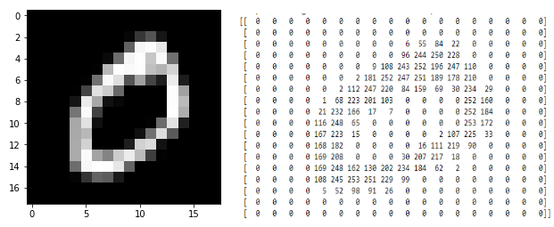
Reading Digital Images: Input to any neural network should be numeric.
Fortunately, images are naturally represented as arrays (or matrices) of numbers.
To summarize: images are made up of pixels.
A number between 0-255 represents the colour intensity of each pixel.
Each pixel's value lies between 0-255.
Each pixel in a colour image is an array representing the intensities of red, blue and green.
The red, blue and green layers are called channels.

Slide 54
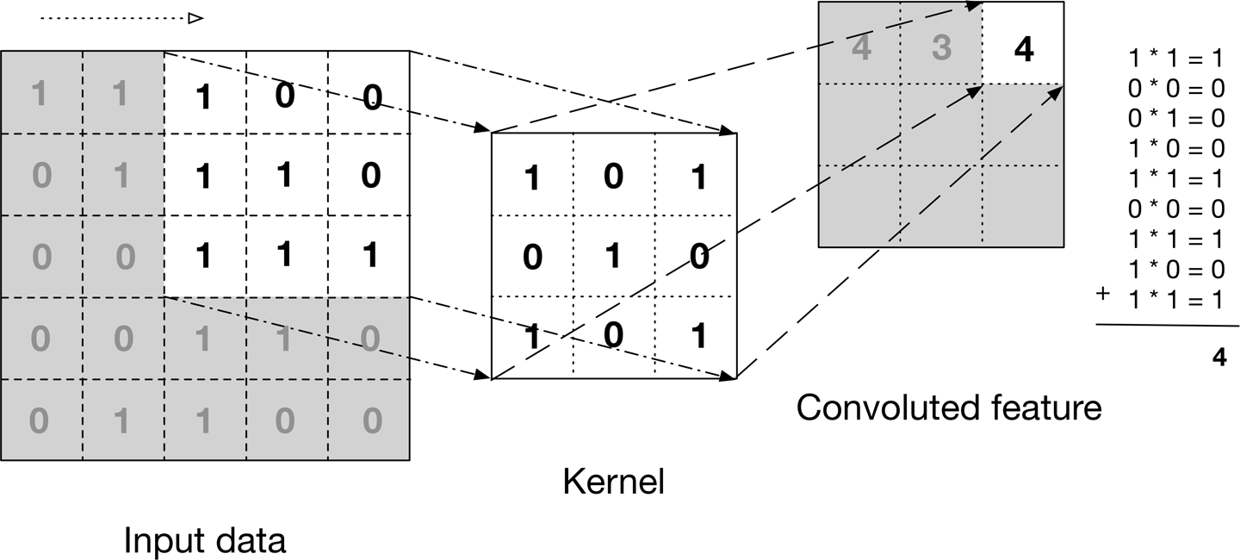
Convolutional layer: The convolutional layer is the first layer of a convolutional network.
The image shows what a convolution is. We take a filter/kernel (3×3 matrix) and apply it to the input image to get the convolved feature. This convolved feature is passed on to the next layer.
The first layer usually extracts basic features such as horizontal or diagonal edges.
This output is passed on to the next layer which detects more complex features such as corners or combinational edges.
As we move deeper into the network it can identify even more complex features such as objects, faces, etc.

Slide 55
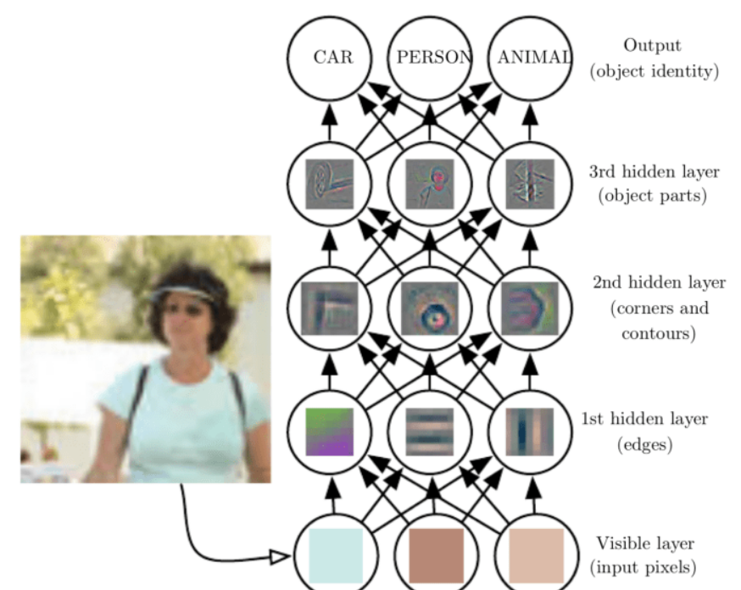
While convolutional layers can be followed by additional convolutional layers or pooling layers, the fully-connected layer is the final layer.
With each layer, the CNN increases in its complexity, identifying greater portions of the image.
As the image data progresses through the layers of the CNN, it starts to recognize larger elements or shapes of the object until it finally identifies the intended object.
After each convolution operation, a CNN applies a Rectified Linear Unit (ReLU) transformation to the feature map, introducing nonlinearity to the model.
Ultimately, the convolutional layer converts the image into numerical values, allowing the neural network to interpret and extract relevant patterns.

Slide 56
Pooling Layer:
Similar to the Convolutional Layer, the Pooling layer is responsible for reducing the spatial size of the Convolved Feature.
This is to decrease the computational power required to process the data by reducing the dimensions.
Pooling layers, also known as down sampling, conducts dimensionality reduction, reducing the number of parameters in the input.
Similar to the convolutional layer, the pooling operation sweeps a filter across the entire input, but the difference is that this filter does not have any weights.
Instead, the kernel applies an aggregation function to the values within the receptive field, populating the output array.
There are two types of Pooling: Max Pooling and Average Pooling.

Slide 57

Max Pooling returns the maximum value from the portion of the image covered by the Kernel. On the other hand, Average Pooling returns the average of all the values.
Max Pooling also performs as a Noise Suppressant. It discards the noisy activations altogether and also performs de-noising along with dimensionality reduction. On the other hand, Average Pooling simply performs dimensionality reduction as a noise suppressing mechanism.
Hence, we can say that Max Pooling performs a lot better than Average Pooling.
Depending on the complexities in the images, the number of such layers may be increased for capturing low-levels details even further.

Slide 58
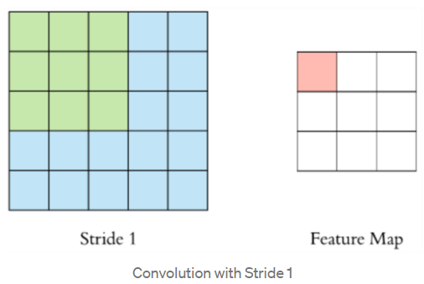
Stride and Padding:
while doing convolutions, each time we computed the element-wise product of the filter with the image, we had moved the filter by exactly one pixel (both horizontally and vertically). But that is not the only way to do convolutions - you can move the filter by an arbitrary number of pixels. This is the concept of stride.
Stride denotes how many steps we are moving in each step-in convolution. By default, it is one.
We can observe that the size of output is smaller than the input.
To maintain the dimension of output as in input, we use padding.
padding helps maintain the size of the output arrays and avoid information loss.
Usually in many layers, we would actually want to shrink the output, but in many others, you maintain the size of the output.

Slide 59
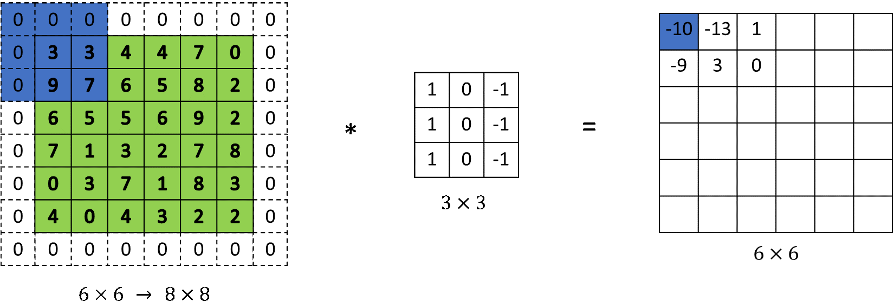
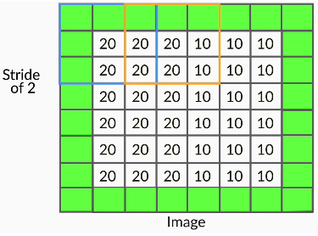
-
Padding is a process of adding zeros to the input matrix symmetrically. In the following example, the extra grey blocks denote the padding. It is used to make the dimension of output same as input.
Two most common ways to do padding:
Populating the dummy row/columns with the pixel values at the edges
Populating the dummy row/columns with zeros (zero-padding)
Padding is Necessary because doing convolutions without padding will 'shrink' the output.

Slide 60
Deep CNNs have multiple CNN units (i.e., feature map-pooling pairs) arranged sequentially, a typical CNN has the following sequence of CNN layers.
We have an input image which is convolved using multiple filters to create multiple feature maps.
Each feature map, of size (c, c), is pooled to generate a (c/2, c/2) output (for a standard 2 x 2 pooling).
The above pattern is called a CNN layer or unit. Multiple such CNN layers are stacked on top of one another to create deep CNN networks.
Note: pooling reduces only the height and the width of a feature map, not the depth (i.e., the number of channels).
convolutional neural networks and their common applications in computer vision such as image classification, object detection, etc. CNNs are not limited to images but can be extended to videos, text, audio etc.

Slide 61
Popular CNN architectures:
Most popular CNN architectures have set the benchmark for state-of-the-art results in computer vision tasks. Also achieved significantly better performance in the ImageNet competition over their predecessors.
Specifically, the architectures like Alex Net, Google Net and Res Net.
Important points:
The depth of the state-of-the-art neural networks has been steadily increasing (from Alex Net with 8 layers to ResNet with 152 layers).
Since these networks have been trained on millions of images, they are good at extracting generic features from a large variety of images.
Thus, they are now commonly being used as commodities by deep learning practitioners around the world.

Slide 62
The Alex Net was one of the very first architectures to achieve extraordinary results in the ImageNet competition (with about a 17% error rate).
It had used 8 layers (5 convolutional and 3 fully connected).
One distinct feature of Alex Net was that it had used various kernels of large sizes such as (11, 11), (5, 5), etc.
Also, Alex Net was the first to use dropouts, which were quite recent back then.
VGGNet has used all filters of the same size (3, 3) and had more layers (The VGG-16 had 16 layers with trainable weights, VGG-19 had 19 layers etc.).
The VGGNet had succeeded Alex Net in the ImageNet challenge by reducing the error rate from about 17% to less than 8%.

Slide 63
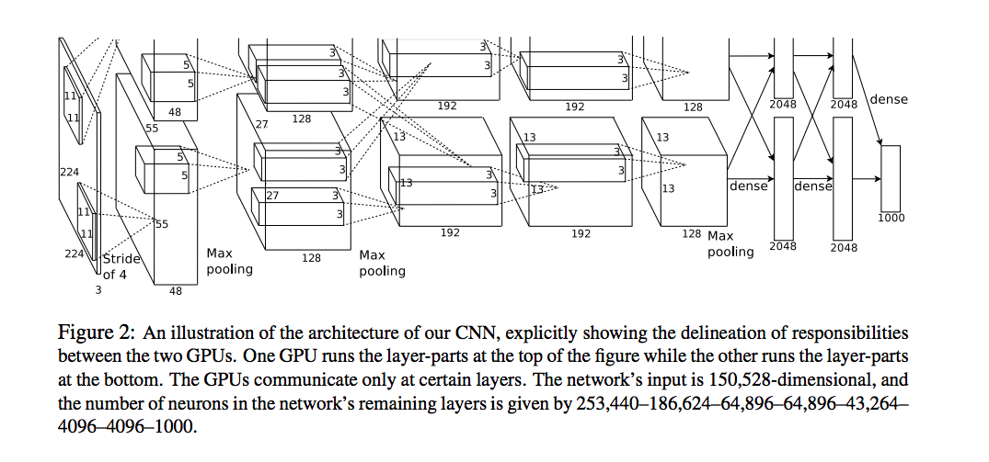
Because of the lack of good computing hardware, it was trained on smaller GPUs (with only 3 GB of RAM).
Thus, the training was distributed across two GPUs in parallel (figure shown below).
Alex Net was also the first architecture to use the ReLU activation heavily.
The key idea in moving from Alex Net to VGGNet was to increase the depth of the network by using smaller filters.
VGG net use a smaller filter of size (3, 3) instead of larger ones such as (5, 5) or (7, 7).

Slide 64
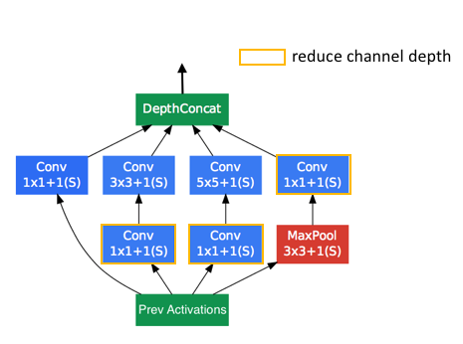
Google Net:
After VGGNet, the next big innovation was the Google Net.
Google Net had won the ILSVRC’14 challenge with an error rate of about 6.7%.
Unlike the previous innovations, which had tried to increase the model capacity by adding more layers, reducing the filter size etc. (such as from Alex Net to VGGNet)
Google Net had increased the depth using a new type of convolution technique using the Inception module.

Slide 65
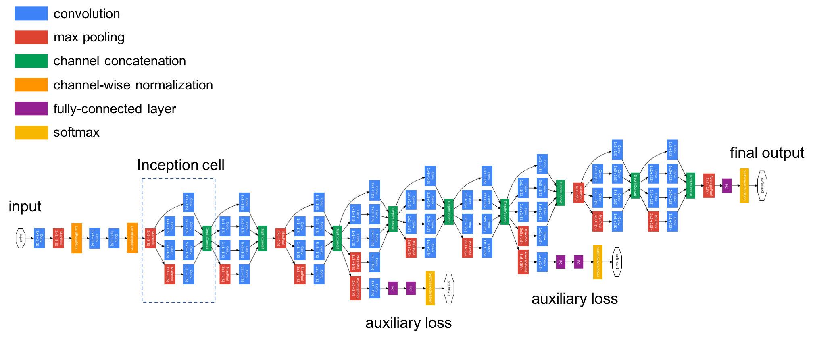

Slide 66
Google Net: To save computation, 1x1 convolutions are used to reduce the input channel depth.
For each cell, we learn a set of 1x1, 3x3, and 5x5 filters which can learn to extract features at different scales from the input.
some important features of the Google Net architecture are as follows:
Inception modules stacked on top of each other, total 22 layers
Use of 1 x 1 convolutions in the modules
Parallel convolutions by multiple filters (1x1, 3x3, 5x5)
Pooling operation of size (3x3)
No FC layer, except for the last SoftMax layer for classification
Number of parameters reduced from 60 million (Alex Net) to 4 million

Slide 67
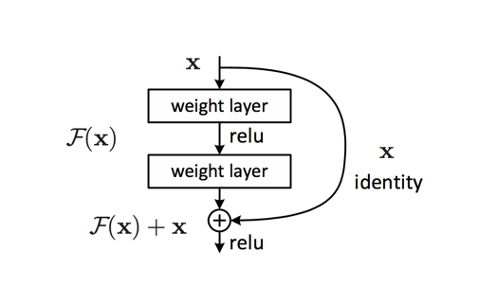
ResNet: The ResNet came up with a novel architecture with skip connections which enabled them to train networks as deep as 152 layers.
The ResNet achieved groundbreaking results across several competitions - a 3.57% error rate on the ImageNet and the first position in many other competitions.
Basic mechanism - The skip connections or residual connections, which enabled the training of very deep networks.
Thus, the skip connection mechanism was the key feature.
Skip connection enabled the training of very deep networks.

Slide 68
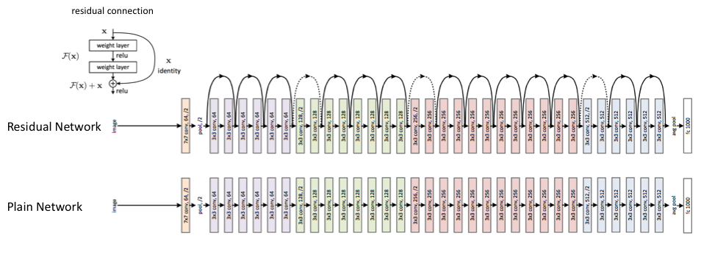

Slide 69
Key features of the ResNet:
ILSVRC’15 classification winner (3.57% top 5 error).
152 layer model for ImageNet, and also has other variants also (with 35, 50, 101 layers).
Every 'residual block' has two 3x3 convolution layers.
No FC layer, except one last 1000 FC SoftMax layer for classification.
Global average pooling layer after the last convolution.
Batch Normalization after every convolution layer.
SGD + momentum (0.9) and No dropout used.

Slide 70
Introduction to Transfer Learning:
As we know that CNNs are feature-extractors, i.e. the convolutional layers learn a representation of an image, which can then be used for any task such as classification, object detection, etc.
This implies that the models trained on the ImageNet challenge have learnt to extract features from a wide range of images.
Can we then transfer this knowledge to solve some other problems as well?
Thus, transfer learning is the practice of reusing the skills learnt from solving one problem to learn to solve a new, related problem.
To summarize, some practical reasons to use transfer learning are as follows:
Data abundance in one task and data crunch in another related task.
Enough data available for training, but lack of computational resources.

Slide 71

THANK YOU

